Slide 1
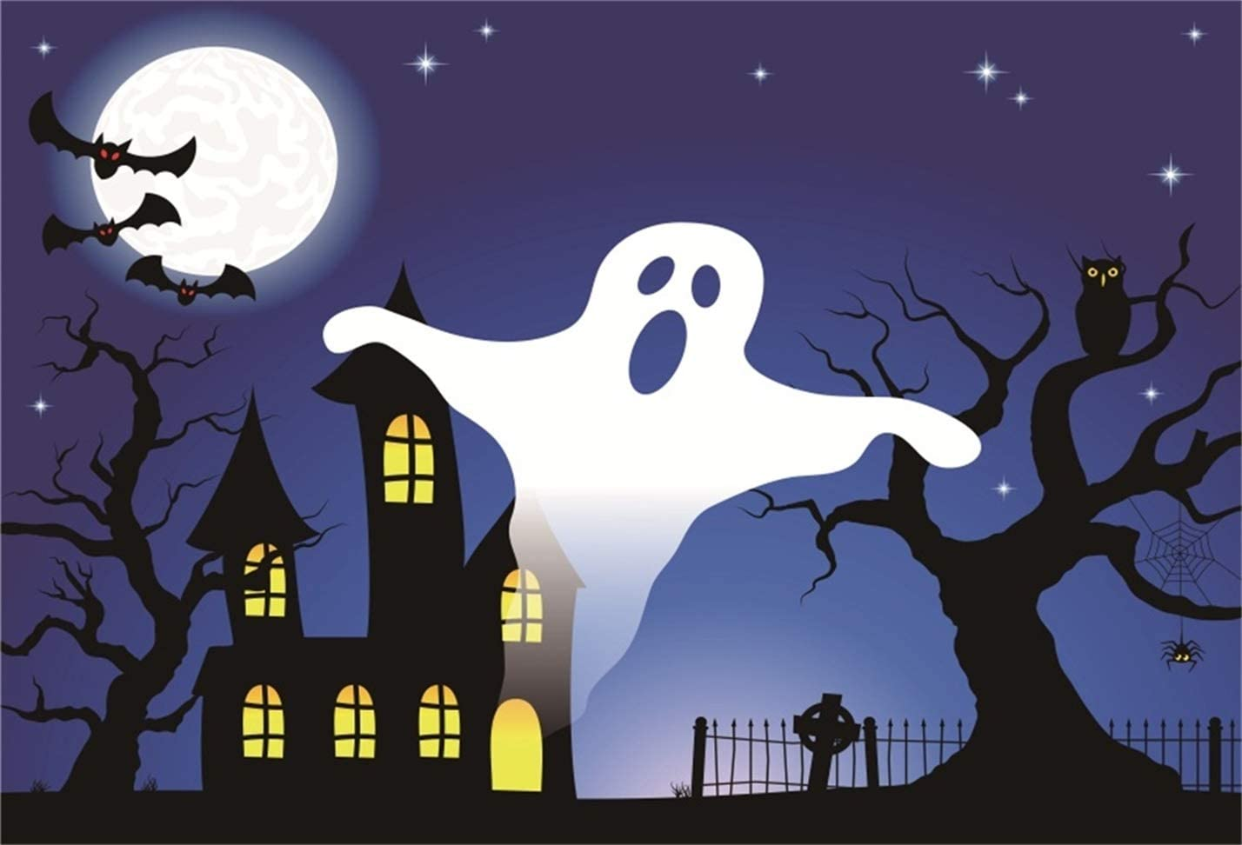
Adding Mixed Numbers
I can add mixed numbers.
https://www.youtube.com/watch?v=pynfj2bYRms

Slide 2
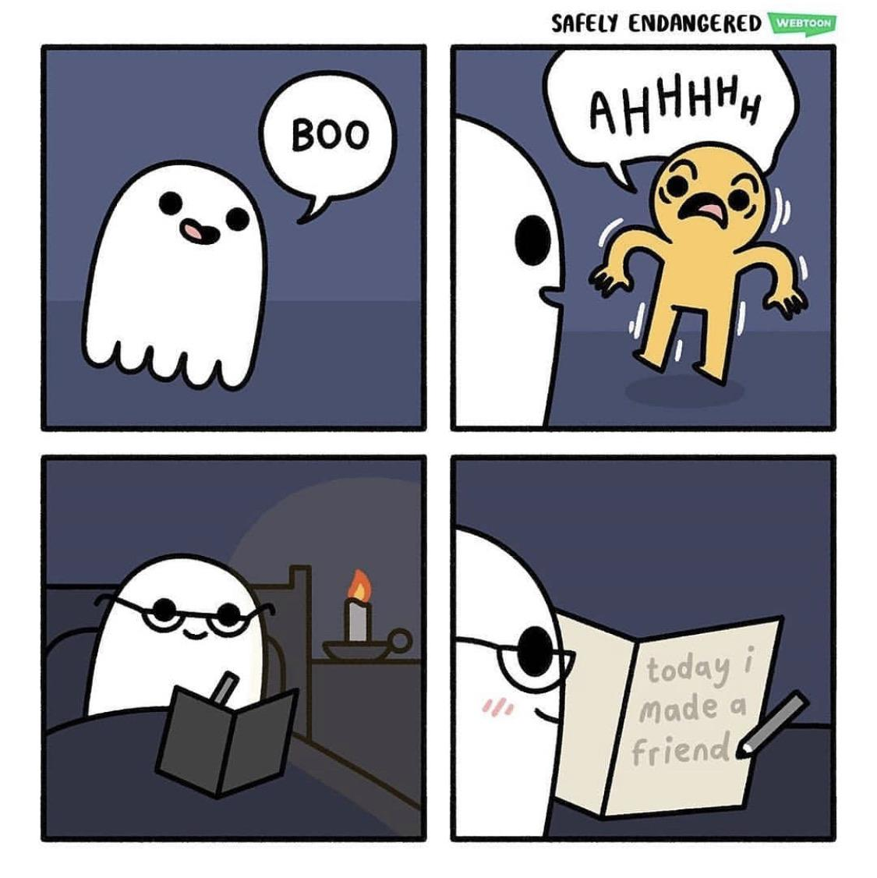
How do I ADD mixed numbers?
Steps to Solve: Find the LCM of the denominators. Write an equivalent fraction for each Add the numerators, and then add the whole numbers. 4. Simplify your answer.

Slide 3
$$2\frac{3}{4}+1\frac{1}{6}$$
Example #1:
$$2\frac{3 x 3}{4 x 3}=$$
+
$$1\frac{1 x 2}{6 x 2}=$$
$$2\frac{9}{12}$$
+
$$1\frac{2}{12}$$
$$3\frac{11}{12}$$

Slide 4
$$6\frac{3}{10}+3\frac{2}{5}$$
Practice #1:
$$6\frac{3}{10}=$$
+
$$3\frac{2}{5}=$$
$$6\frac{3}{10}$$
+
$$3\frac{4}{10}$$
$$9\frac{7}{10}$$

Slide 5
$$17\frac{1}{6}+12\frac{1}{4}$$
Practice #2:
$$17\frac{1}{6}=$$
+
$$12\frac{1}{4}=$$
$$17\frac{2}{12}$$
+
$$12\frac{3}{12}$$
$$29\frac{5}{12}$$

Slide 6
What if my fraction answer has an improper fraction in it?
Follow the same steps from above, except change the improper fraction to a mixed number, and then add the whole numbers.

Slide 7
$$2\frac{2}{3}+1\frac{3}{4}$$
EXAMPLE
$$2\frac{2}{3}=$$
+
$$1\frac{3}{4}=$$
$$2\frac{8}{12}$$
+
$$1\frac{9}{12}$$
$$3\frac{17}{12}$$
= $4\frac{5}{12}$

Slide 8
$$48\frac{9}{11}+2\frac{1}{4}$$
Practice #1:
$$48\frac{9}{11}=$$
+
$$2\frac{1}{4}=$$
$$48\frac{36}{44}$$
+
$$2\frac{11}{44}$$
$$50\frac{47}{44}$$
= $51\frac{3}{44}$

Slide 9
$$15\frac{5}{6}+18\frac{2}{3}$$
Practice #2:
$$15\frac{5}{6}=$$
+
$$18\frac{2}{3}=$$
$$15\frac{5}{6}$$
+
$$18\frac{4}{6}$$
$$33\frac{9}{6}$$
= $34\frac{3}{6}$
= $34\frac{1}{2}$

Slide 10
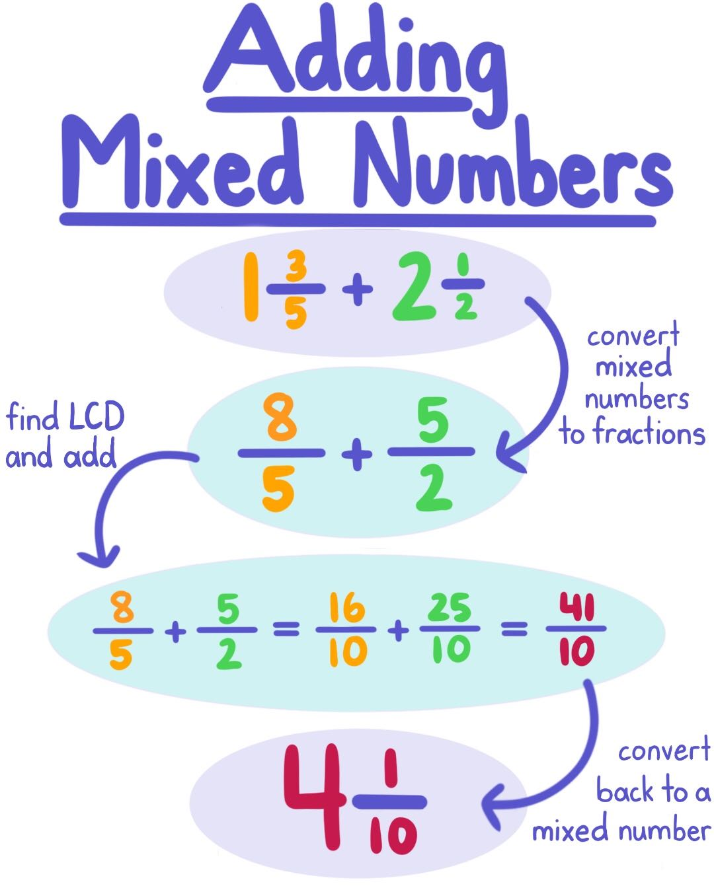
Another way…

Slide 11
EXAMPLE #1
$$6\frac{1}{4}+3\frac{2}{5}$$
$$6\frac{5}{20}$$
₊
$$3\frac{8}{20}$$
$$6\frac{1}{4}=$$
+
$$3\frac{2}{5}=$$
= $9\frac{13}{20}$

Slide 12
Partner Practice & Homework Time
Remember:
Each of you needs to solve every problem.
If you are stuck and can’t figure it out together, ask for help!
Once you are checked you may start on homework.
Homework:
“What Do Frogs Say When They Meet Each Other?”
Riddle Worksheet

