Slide 1
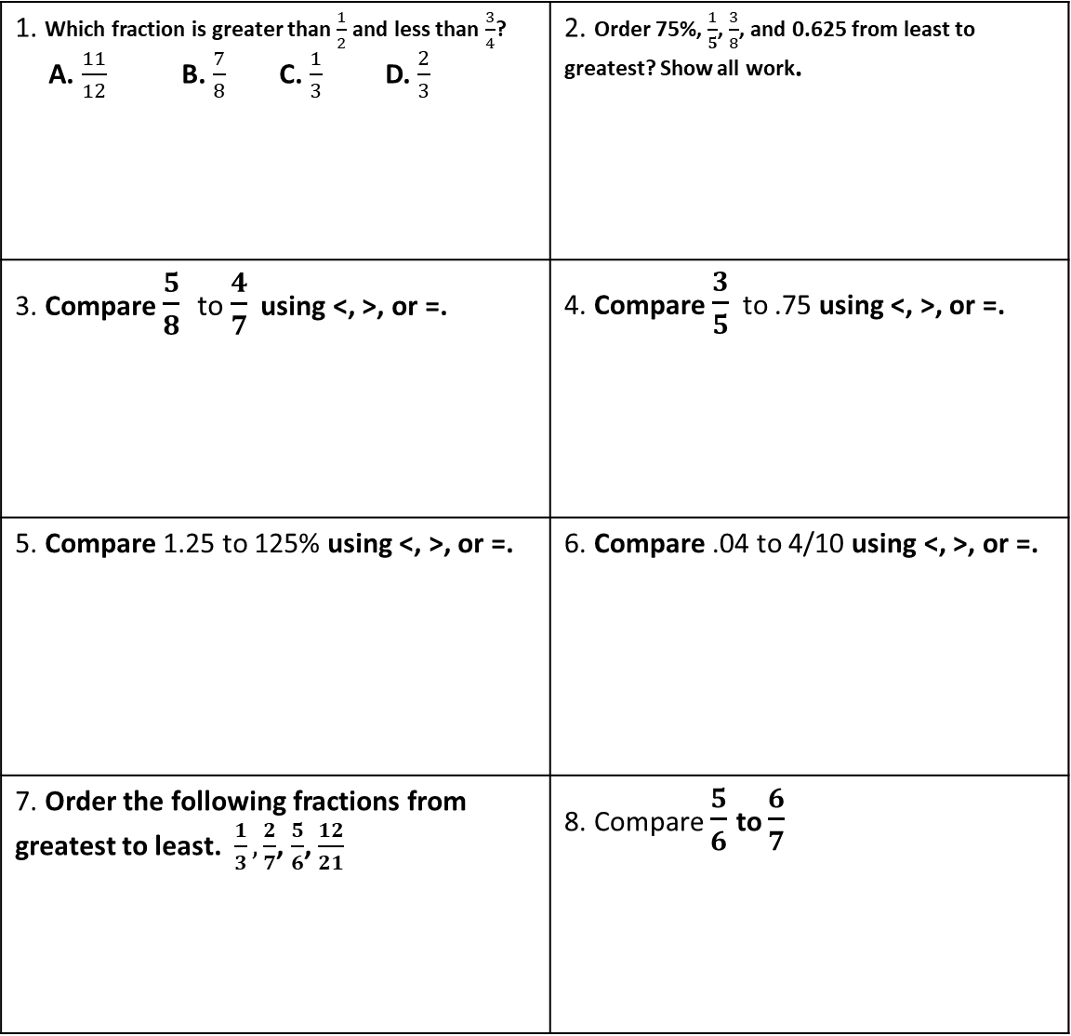
TO COMPARE FRACTIONS, DECIMALS, AND PERCENTS TO EACH OTHER: Turn both numbers into a decimal. Ex: Compare 1/8 to 12% 1/8= .125 12%= .12 or .120 so 1/8 > .125
Station #1
Comparing and Ordering Fraction, Decimals & Percents
Use a common denominator to create new fractions.
Order the new numerators.
1. Which fraction is greater than $\frac{1}{2}$ and less than $\frac{3}{4}$? A. $\frac{11}{12}$ B. $\frac{7}{8}$ C. $\frac{1}{3}$ D. $\frac{2}{3}$ | 2. Order 75%, $\frac{1}{5}$, $\frac{3}{8}$, and 0.625 from least to greatest? Show all work.
3. Compare $\frac{5}{8}$ to $\frac{4}{7}$ using <, >, or =. | 4. Compare $\frac{3}{5}$ to .75 using <, >, or =.
5. Compare 1.25 to 125% using <, >, or =. | 6. Compare .04 to 4/10 using <, >, or =.
7. Order the following fractions from greatest to least. $\frac{1}{3}, \frac{2}{7}$, $\frac{5}{6}$, $\frac{12}{21}$ | 8. Compare $\frac{5}{6}$ to $\frac{6}{7}$

Slide 2
28% = .28
Station # 2 Review Converting between Percents & Decimals
1. What is 0.02% written as a decimal? | 2. What is 24 written as a percent? | 3. What is 17% written as a decimal?
4. What is 0.02 written as a percent? | 5. What is 1.25% written as a decimal? | 6. What is 240% written as a decimal?
7. What is 2.45 written as a percent? | 8. What is .0125 written as a percent? | 9. What is 3 written as a percent?
10. What is 300% written as a decimal? | 11. What is .347 written as a percent? | 12. What is 3% written as a decimal?

Slide 3
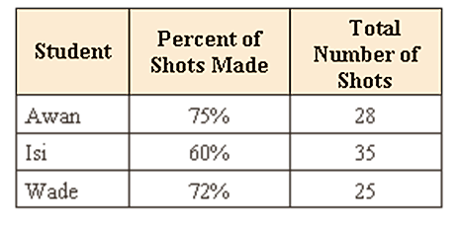
Station # 3 Review the Percent Proportion Word Problems
1. What is the percent proportion? Draw it. | 2. Show the steps of how to use the following proportion to solve for x.
3. What word tells you that a number is the part? | 4. What word tells you that the number is the whole?
Reminder: When solving percent word problems, add labels to your proportion to make sure the part matches the part and whole matches the whole. Example: 7 students like math = 35% of students like math 20 total students 100% (total)
How many shots did Awan make? Proportion with labels: Answer: | According to the school survey, 12% of the students at BEMS speak Spanish. There are 36 students at the school who speak Spanish. How many students were surveyed? Proportion with labels: Answer:
A recipe for salsa uses 65% tomatoes. If a batch contains 5.2 cups of tomatoes, how large is the batch of salsa? Proportion with labels: Answer: | James completed 18 math problems. This is 30% of the problems he has to do. How many problems must he do? Proportion with labels: Answer:

Slide 4
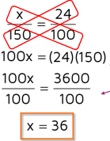
Station # 4 Review the Percent Proportion Basic Problems
Set up the proportion.
Multiply the two numbers that are diagonal from each other.
Divide by the lonely number.
What word tells you that a number is the part? | What word tells you that the number is the whole?
What is 24% of 80? Proportion with : Answer: | 16 is what percent of 20? Proportion with : Answer:
10.2 is 85% of what number? Proportion with : Answer: | What is 120% of 60? Proportion with : Answer:
6 is 75% of what number? Proportion with : Answer: | 18 is what percent of 54? Proportion with : Answer:

