Slide 1
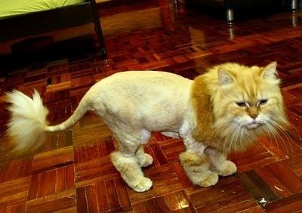
Ch. 2 Lesson 7 Percent of a Number
I can find percent of a number using a percent proportion.
What does a percent look like in fraction form?

Slide 2
The Percent Proportion
Part (is) | = | Percent (%)
Whole (of) |  | 100

Slide 3
How do I set up the percent proportion?
Example #1 What comes before “is” is the part. What comes after “of” is the whole. % (on top of 100) is always set equal to the part.
3 is 75% of 4.

Slide 4
Example 1:
What is 90% of 20?

Slide 5
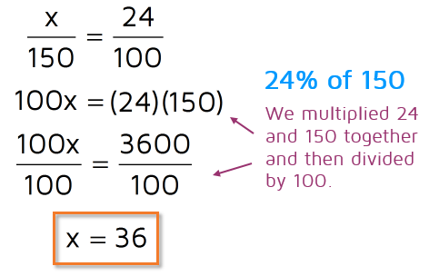
How do I use the Percent Proportion to find Percent of a Number?
Example # 3 What is 24% of 150?
36 is 24% of 150
This makes sense because 36 is 30 x 4= 120 and 40 x 4= 160.
(is) | = | (%)
(of) |  | 100
Steps
Cross multiply.
Divide by the number that is with the variable.
Fill your answer into the statement where it said “what” to see if it makes sense!

Slide 6
You Try! a. What is 30% of 26? b. What is 14% of 120?

Slide 7
Percent of a Number Solve and Color! Get your answers checked before you color!
Partner Practice

Slide 8
Homework Time Ya’ll
Finish your
Solve and Color.
Full color for
DAWG BUCKS!

