Slide 1
Finding Percent of a Number Using
the Percent Proportion
What is the Percent Proportion?
(is) | = | (%)
(of) |  | 100
How do I set up the percent proportion?
Example #1
What comes before “is” is the ________. What comes after “of” is the _________. ________(on top of 100) is always set equal to the part.
Example # 2
3 is 75% of 4.
What is 90% of 20?

Slide 2
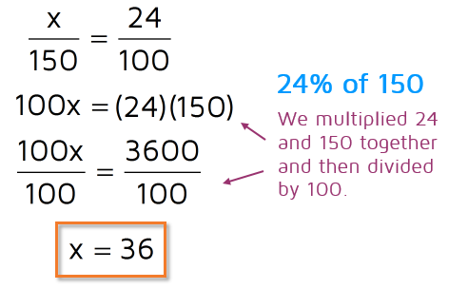
How do I use the Percent Proportion to find Percent of a Number?
Example # 3 What is 24% of 150?
36 is 24% of 150
This makes sense because 36 is 30 x 4= 120 and 40 x 4= 160.
You Try!
a. What is 30% of 26? b. What is 14% of 120?
(is) | = | (%)
(of) |  | 100
Steps
Set up the proportion.
Cross multiply.
Divide by the number that is with the variable.
Fill your answer into the statement where it said “what” to see if it makes sense!

