Slide 1
Happy Thursday!
Objective: I can write decimals as fractions
Do Now: Bellwork
Agenda:
Bellwork
Go over homework
Chapter 1 Lesson 1
Notes
Partner Practice
Independent Practice

Slide 2
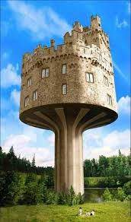
Ch 2, L1- day 1 Decimals & Fractions
I can write decimals as fractions or mixed numbers in simplest form.
When is it better to use a fraction or a decimal?

Slide 3
Vocab-
RATIONAL NUMBER- any number that can be written as a fraction

Slide 4
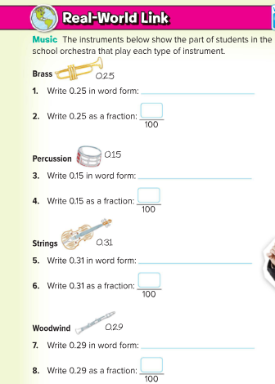
Page 89

Slide 6
Orange Resource Sheet
Use this to help with decimal, fraction, and percent conversions.

Slide 7
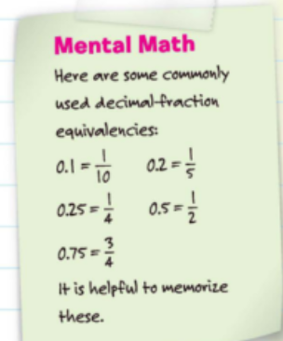
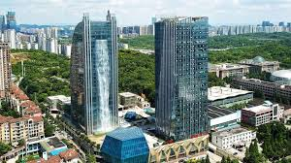
Page 90

Slide 8
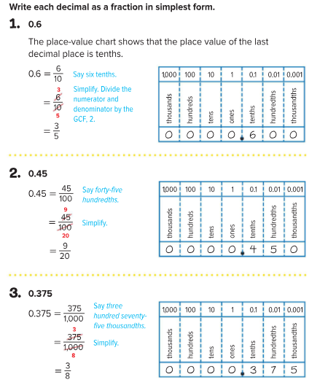
Page 90

Slide 9
Page 90

Slide 10
Page 90

Slide 11
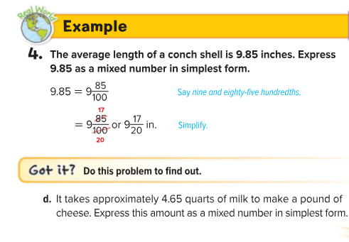
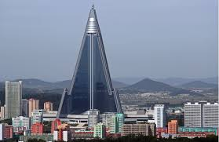
Page 91

Slide 14
Partner Work Time
Complete #1-15 on your worksheet with your partner.
Remember to show your work!

Slide 15
Homework Time!
Decimals to Fractions Worksheet #1-11
Show ALL work!
Weekly Review is due tomorrow as well.

Slide 16
Extra practice

Slide 17
PRACTICE!
0.6
10.9
0.08
4) 6.25

Slide 18
PRACTICE!
0.6
10.9
0.08
4) 6.25

