Slide 1
Chapter 5 Lesson 1- Integers
Objective: I can identify and graph integers. I will demonstrate my understanding by scoring a 4/5 on my exit slip.
What is an integer? Watch the video. Explain in your own words what integer is and how we use integers.
https://indiana.pbslearningmedia.org/resource/2b47a62a-b3f1-4077-a65d-92856d65a87c/i-3-math-integers/

Slide 2
Introduction to Integers

Slide 3
Negative Numbers

Slide 4
Opposites

Slide 6
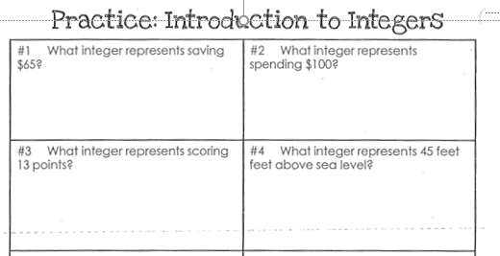

Slide 7
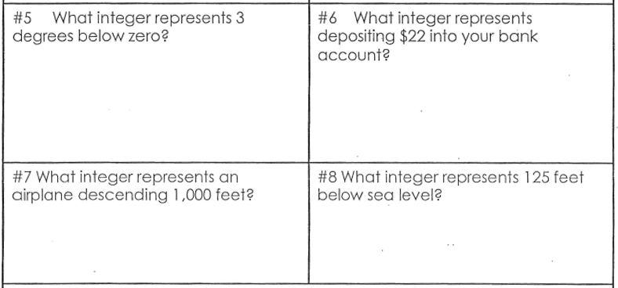

Slide 8
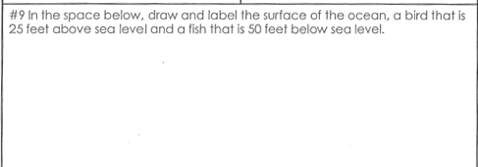

Slide 9
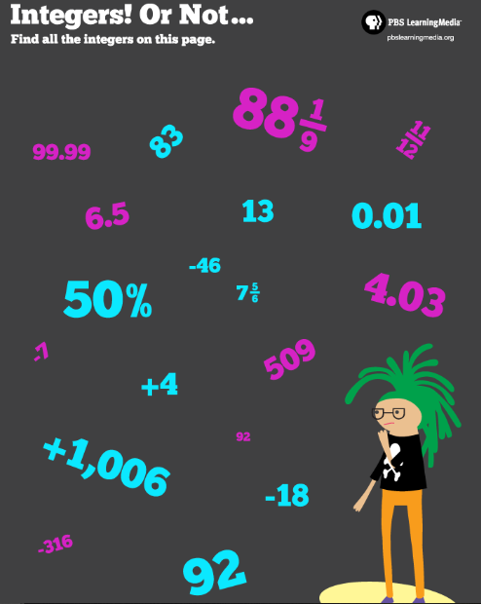

Slide 10
P. 347

Slide 11
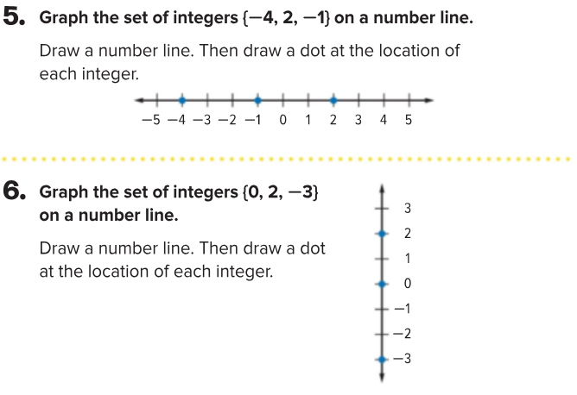
P. 347

Slide 12
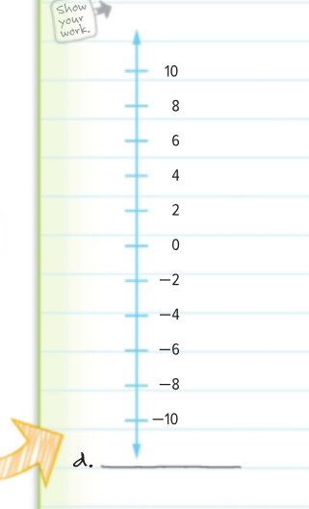
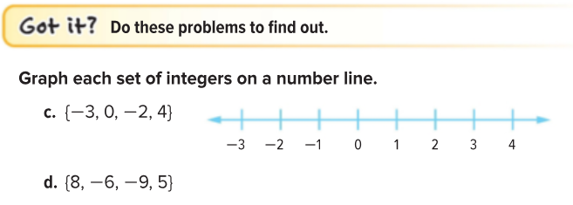
I can graph integers
P. 347

Slide 13
What does zero mean?

Slide 14
Show What You Know
Partner Practice:
Identify Integers Coloring Page
On Your Own:
Exit Slip
3. Homework:
P. 349 #1-7

