Slide 1
Chapter 5 Lesson 2- Absolute Value
Objective: I can find and apply the absolute value of integers. I will demonstrate my understanding by scoring a 4/5 on my exit ticket.
Review:
What is an integer?
Why do we need integers?
What is absolute value? Watch the video. Explain in your own words what absolute value is and why we need it.
https://indiana.pbslearningmedia.org/resource/muen-math-ns-absvalue/absolute-value/

Slide 3
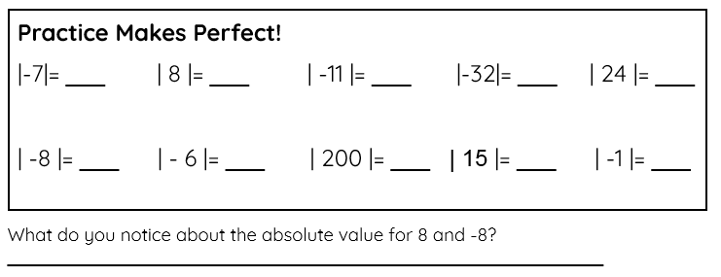

Slide 4
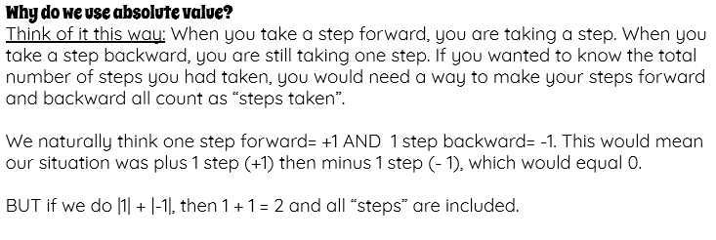
Watch me demonstrate.

Slide 5
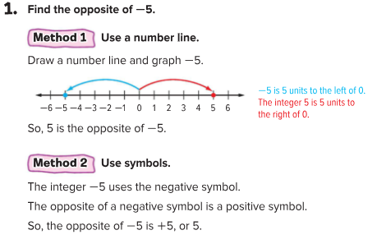
How do I find an opposite?
P. 356

Slide 6
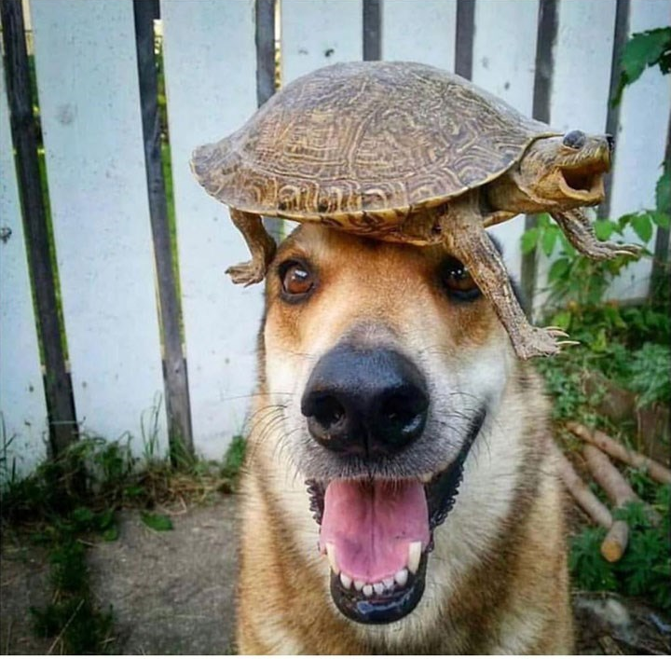
How do I find an opposite?
P. 356

Slide 7
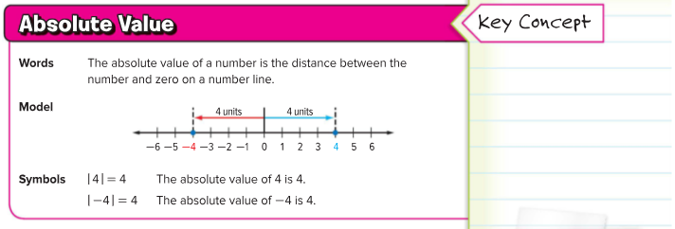
How can I apply absolute value?
P. 357

Slide 8
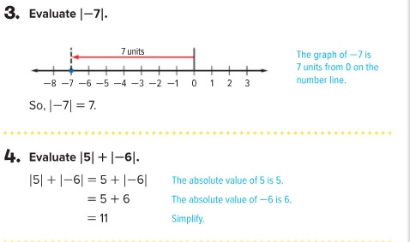
How can I apply absolute value?
P. 357

Slide 9
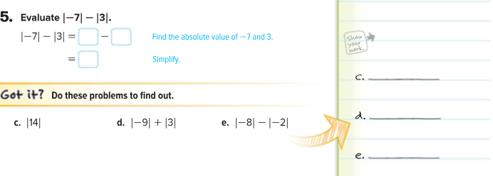
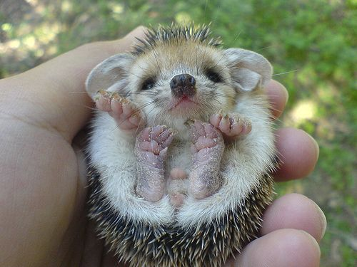
How can I apply absolute value?
P. 357

Slide 10
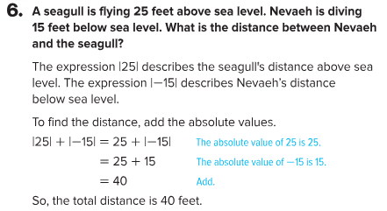
How is absolute value used in real life?
P. 358

Slide 11
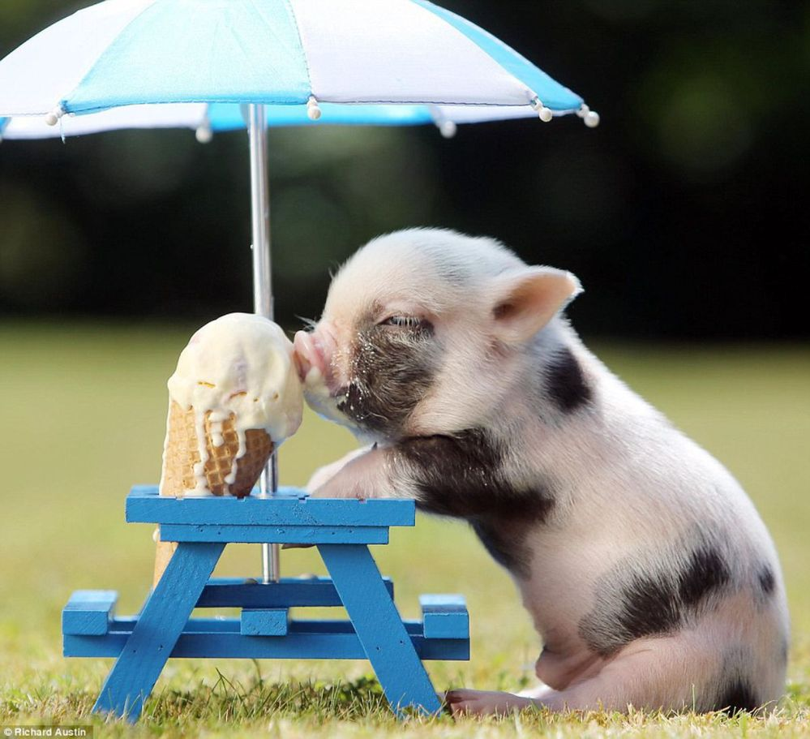
Show What You Know
Partner Practice:
P. 358 #1-6
On Your Own:
Exit Slip
3. Homework:
P. 359 #1-11, #14-16, AND P. 360 #17-18

