Slide 1
Dividing with whole numbers and fractions
Objective: I can divide whole numbers by fractions.
I can divide fractions by fractions.
What are some key words that signal division?
See if you can identify the rule in the video!
https://www.youtube.com/watch?v=nMZJKGyu-Kk

Slide 2
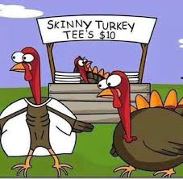
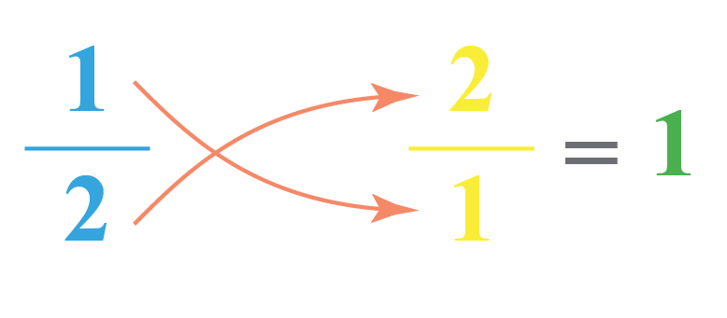
Vocab:
Reciprocal: any two numbers with a product of 1
**another name for reciprocal is ‘multiplicative inverse’

Slide 3
p. 306

Slide 4
GOT IT……
p. 306

Slide 5
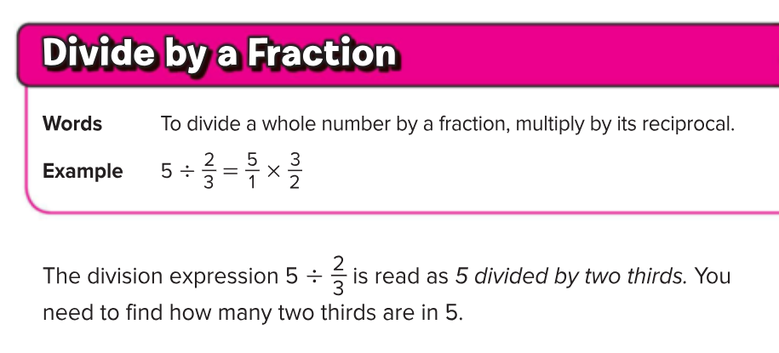
p. 307
Draw this visual example

Slide 6
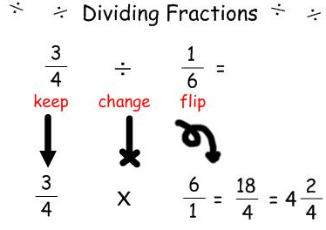
$$9 ÷ \frac{1}{3}$$
$$\frac{9}{1} x \frac{1}{3}$$
Cross cancel!
=$3$

Slide 7
GOT IT
p. 307

Slide 8
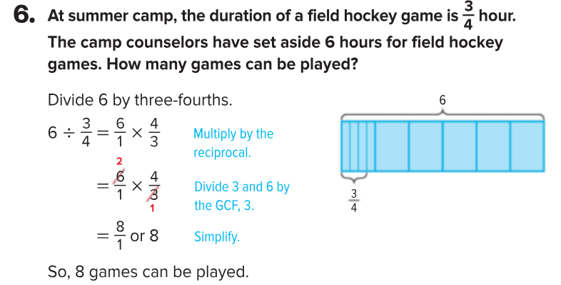
WORD PROBLEMS…..P. 308

Slide 9
You Try! #7 on p. 308
p. 308

Slide 10
p. 318
**KEEP, CHANGE, FLIP**

Slide 11
P. 318 Example 1, Method 2

Slide 12
p. 318

Slide 13
p. 319
$$\frac{5}{7} ÷10$$

Slide 14
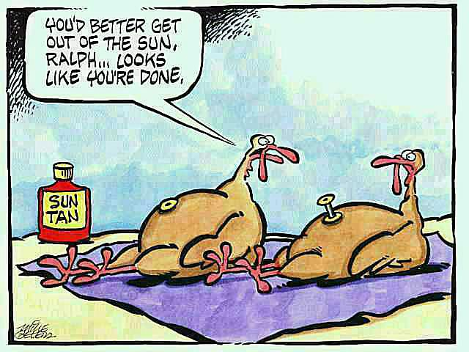
p. 319
Got It?

Slide 15
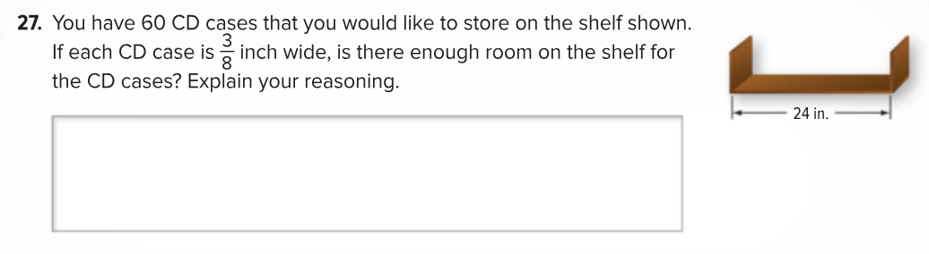
p. 324
Let’s practice…..

Slide 16
Show What You Know
With a Partner: P. 320 #1-3 and #5
By Yourself: EXIT SLIP
By Yourself: Homework p. 321 #1-6 AND #8-10

