Slide 1
Dividing with Mixed numbers- day 2
Objective: I can divide with mixed numbers as shown by mastering my exit slip.
Review: What is a reciprocal? –Partner A
How do we MULTIPLY mixed numbers? –Partner B
How do we DIVIDE fractions? –Partner ??

Slide 2
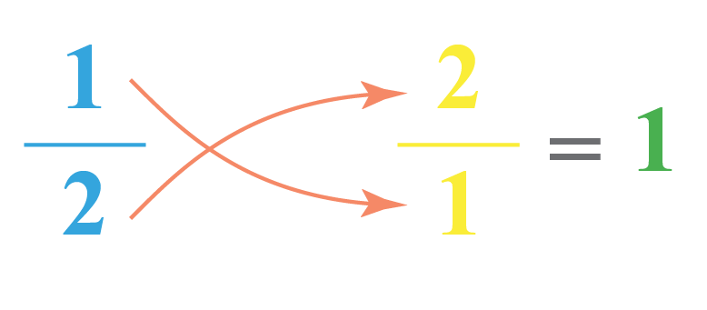
Review:
Reciprocal: any two numbers with a product of 1
**another name for reciprocal is ‘multiplicative inverse’

Slide 3
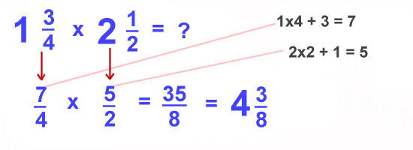
What are the steps?

Slide 4
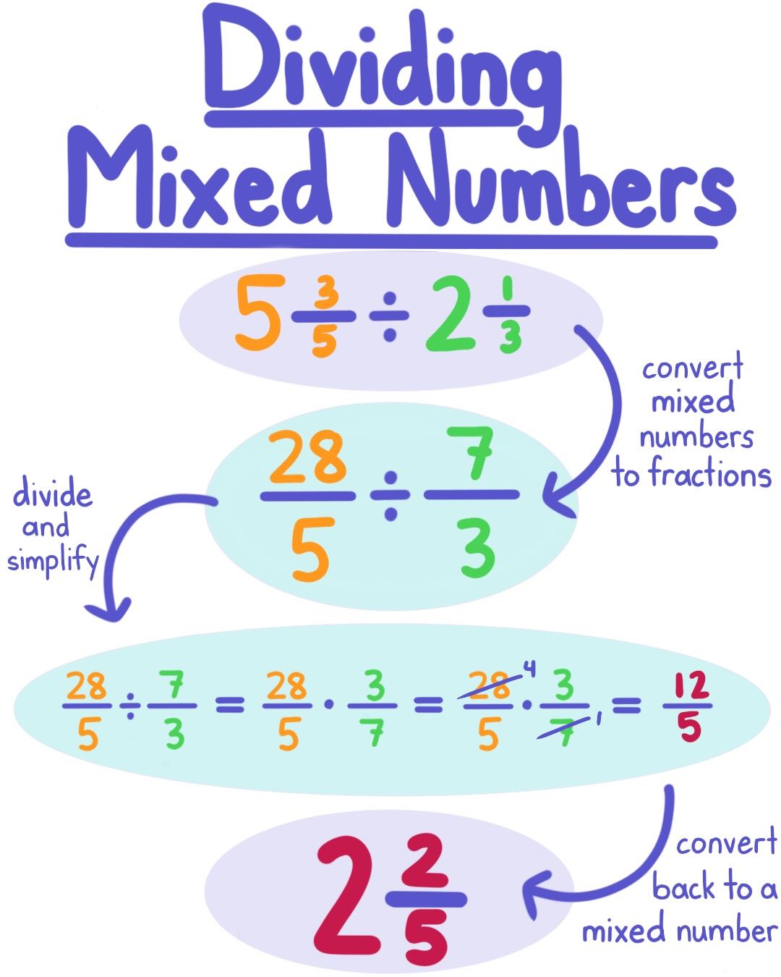

Slide 5
p. 326

Slide 6
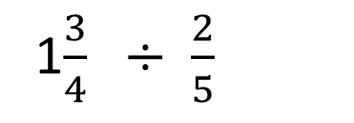
1$\frac{3}{4} ÷ \frac{2}{5}$

Slide 7
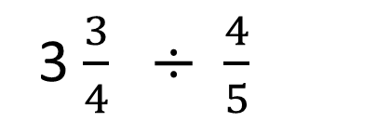
3 $\frac{3}{4} ÷ \frac{4}{5}$

Slide 8
GOT IT……
p. 326

Slide 9
p. 327

Slide 10
GOT IT….
p. 327

Slide 11
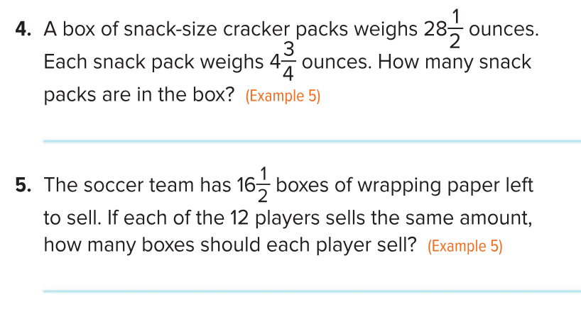
p. 328
Let’s practice word problems …..

Slide 12
Dividing With Mixed Numbers- day 2
Exit Ticket: divide fractions
Homework p. 331 #11-22 all

