Slide 1
Multiplying Mixed Numbers
Objective: I can multiply mixed numbers as shown by scoring at least 4/5 on my exit slip.
How do you multiply fractions?
How do you turn a mixed number into an improper fractions?

Slide 2
Can you identify the steps?
We are going to watch a Number Rock video on multiplying mixed numbers. There are 3 steps. See if you can find them.
https://www.youtube.com/watch?v=lQJuF5okZsI

Slide 3
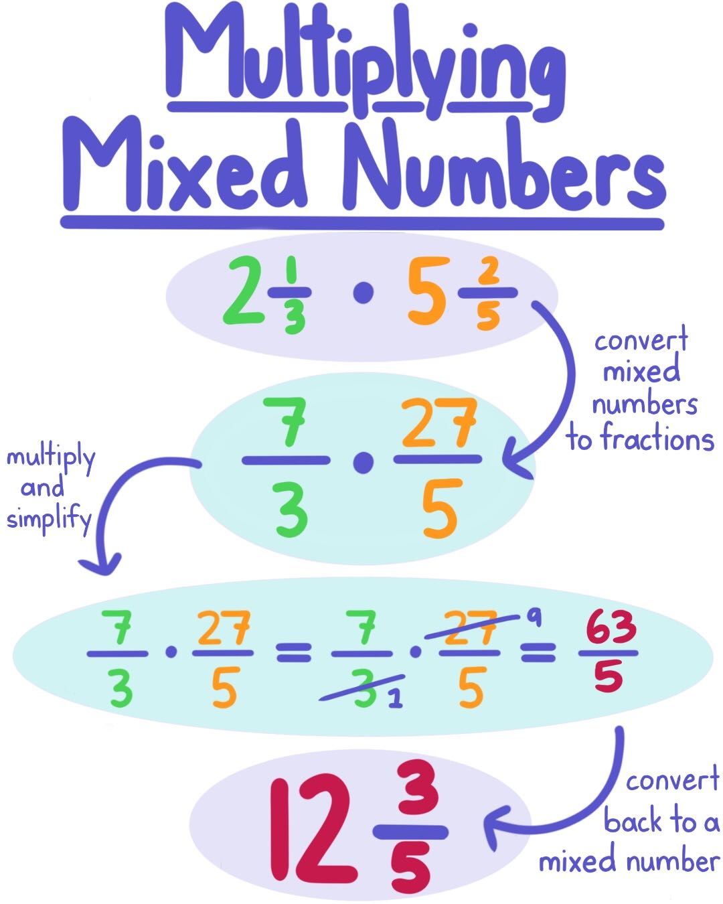
STEP 1
STEP 2
STEP 3

Slide 4
p. 282

Slide 5
p. 282

Slide 6
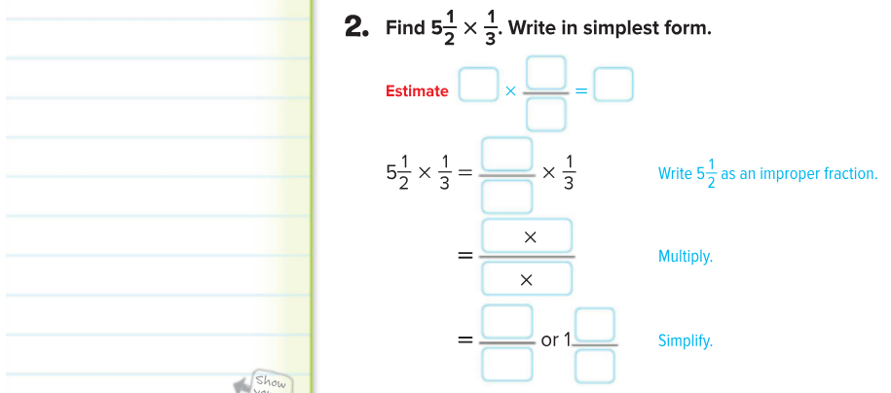
p. 282

Slide 7
p. 282

Slide 8
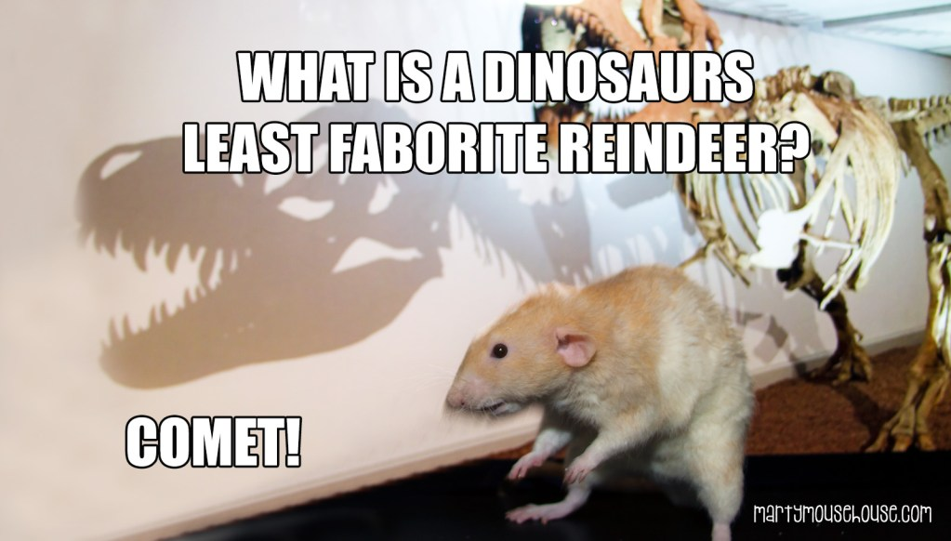
p. 283

Slide 9
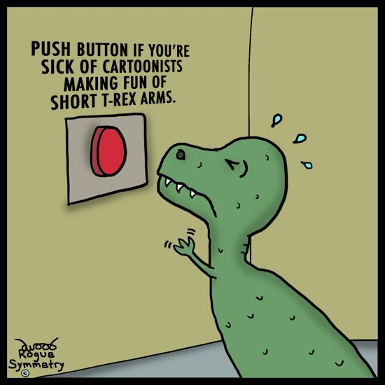
p. 283

Slide 10
p. 283

Slide 11
p. 284

Slide 12
Show What You Know
First: Partner Practice p. 284 #1-5
Second: Exit Slip
Third: Homework p. 285 #1-10

