Slide 1
Objectives:
I can cross cancel to make multiplication easier.
I can multiply fractions by fractions.
I can multiply fractions by whole numbers

Slide 2
Steps
Multiply numerators by numerators.
Multiply denominators by denominators.
Simplify if necessary.

Slide 3
Got it?

Slide 4
This is called cross canceling.
If we hadn’t cross canceled, we would
have to reduce at the end.
$$\frac{2}{3}×\frac{5}{6}=\frac{10}{18}=\frac{5}{9}$$

Slide 5


Let’s Practice!
$\frac{2}{6}$ x $\frac{3}{8}$ = x
$\frac{5}{7}$ x $\frac{21}{25}$ = x
$\frac{2}{9}$ x $\frac{3}{11}$ = x
$\frac{11}{20}$ x $\frac{3}{44}$ = x
$\frac{27}{31}$ x $\frac{8}{33}$ = x
$\frac{3}{7}$ x $\frac{13}{21}$ = x
$\frac{12}{21}$ x $\frac{3}{8}$ = x
$\frac{35}{39}$ x $\frac{3}{5}$ = x

Slide 6
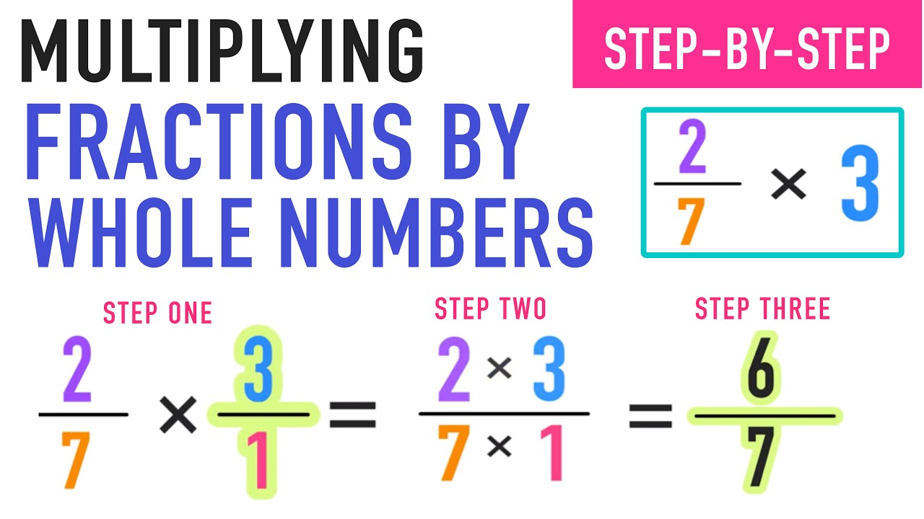
Steps
Write the whole number as a fraction over 1.
Multiply numerators by numerators.
Multiply denominators by denominators.
Simplify if necessary.

Slide 7
Got It?

Slide 8
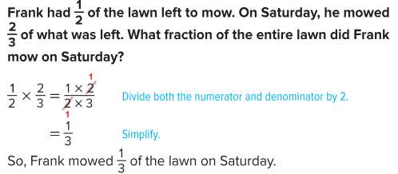
Word Problems
In word problems, if you see the word “of” after a fraction, it means multiply.

Slide 9
Got It?
The bleachers at a football game are 7/8 full, and ½ of the fans in the bleachers are rooting for the home team. What fraction of the bleachers are filled with home team fans?

Slide 10
Partner Practice Time
P. 276 #1-7 and P. 279 #23
Once you get checked… work on your homework! P. 277 #1-10 AND P. 280 #26-27

