Slide 1
Subtracting Mixed Numbers
I can subtract mixed numbers.

Slide 2
How do I SUBTRACT mixed numbers?
Steps to Solve: Convert the mixed numbers to improper fractions by multiplying the denominator by the whole number, and then add the product to the numerator. Find the LCM of the denominators. Write an equivalent fraction for each. Subtract the numerators. Convert your improper fraction to a mixed number. Simplify your answer.

Slide 3
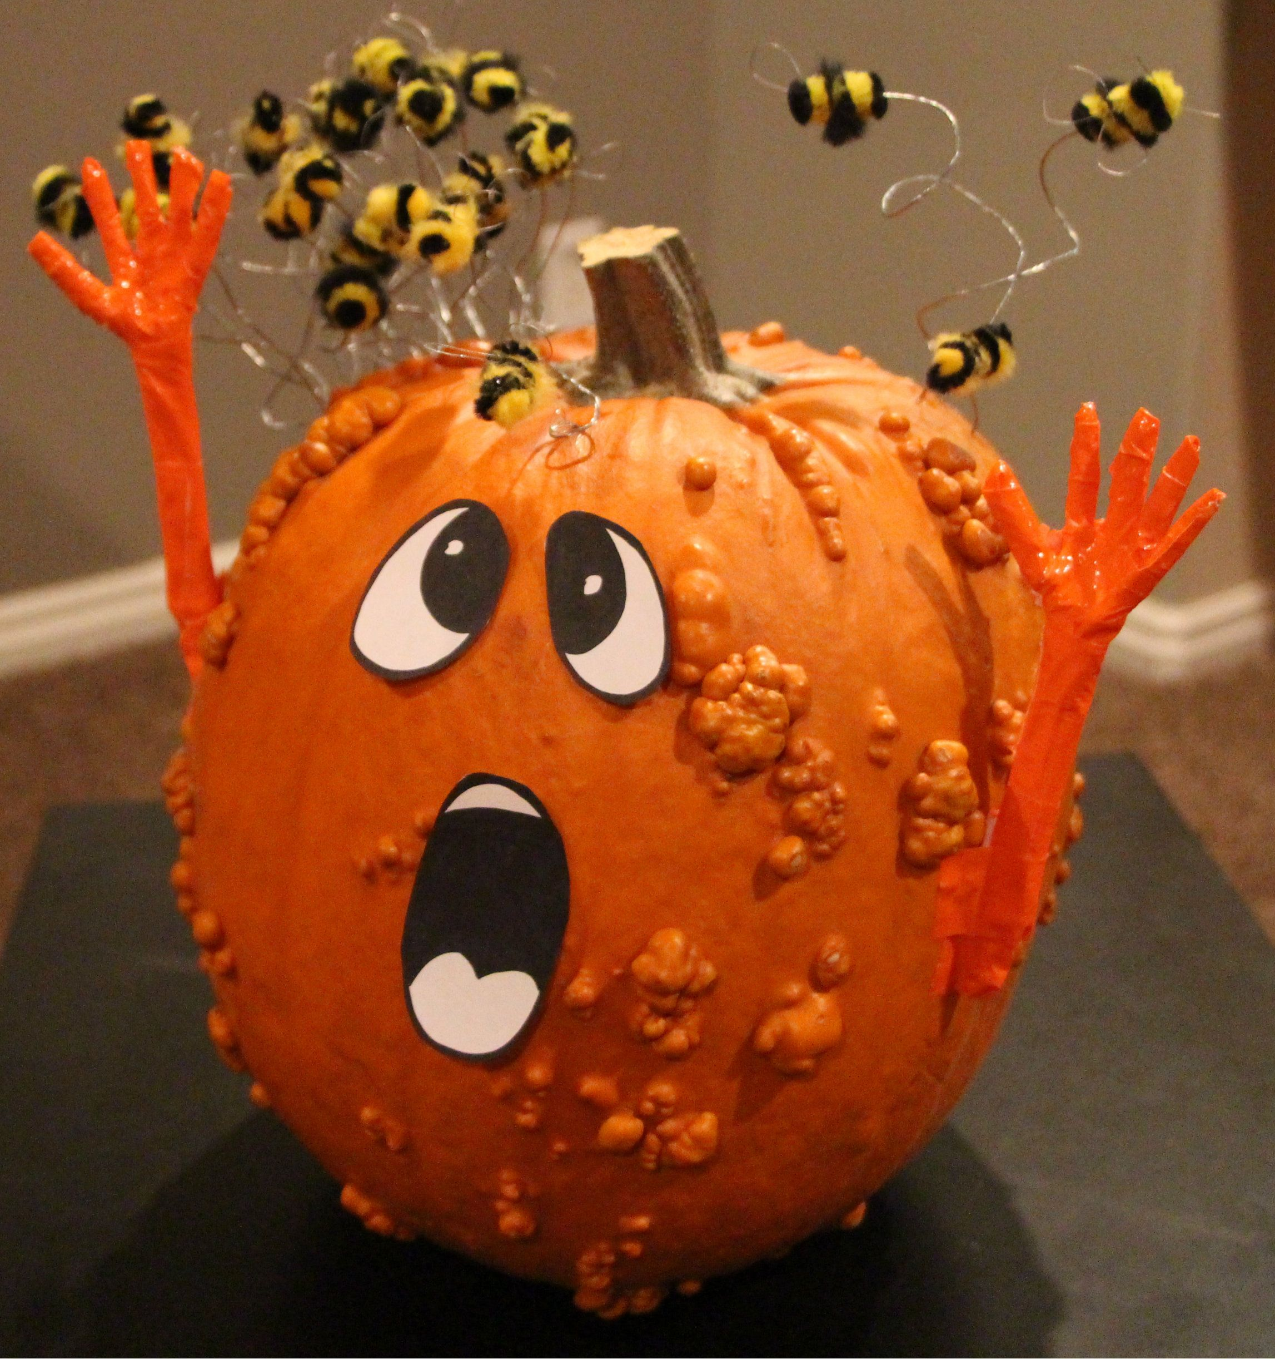
$$3\frac{9}{10}−1\frac{2}{5}$$
Example #1:
$$\frac{39}{10}$$
-
$$\frac{7}{5}$$
$$\frac{39}{10}$$
-
$$\frac{14}{10}$$
$$\frac{10 x 3+9}{10}−\frac{5 x 1+2}{5}$$
$\frac{39}{10}−\frac{7}{5}$
$$\frac{25}{10}$$
=$2\frac{5}{10}$
=$2\frac{1}{2}$

Slide 4
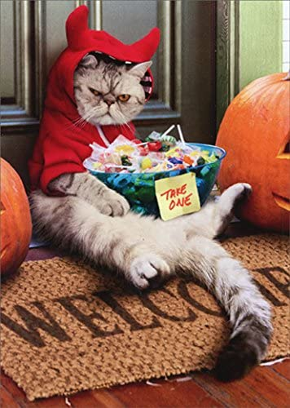
$$8\frac{4}{5}−5\frac{1}{3}$$
Practice #1:
$$\frac{44}{5}$$
-
$$\frac{16}{3}$$
$$\frac{132}{15}$$
-
$$\frac{80}{15}$$
$$\frac{5 x 8+4}{5}−\frac{3 x 5+1}{3}$$
$\frac{44}{5}−\frac{132}{15}$
$$\frac{52}{15}$$
=$3\frac{7}{15}$

Slide 5
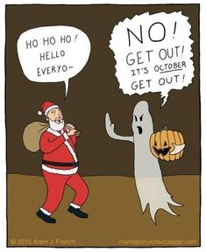
$$9\frac{5}{6}−2\frac{3}{5}$$
Practice #2:
$$\frac{59}{6}$$
-
$$\frac{13}{5}$$
$$\frac{295}{30}$$
-
$$\frac{78}{30}$$
$$\frac{6 x 9+5}{6}−\frac{5 x 2+3}{5}$$
$\frac{59}{6}−\frac{13}{5}$
$$\frac{217}{30}$$
=$7\frac{7}{30}$

Slide 6
How do I use borrowing to subtract mixed numbers?
Borrowing → Steps to Solve: Borrow from the first whole number. Must go “next door” to borrow (take 1 away) from the whole number. Then, add the denominator and the numerator. This sum is the new numerator, keep old denominator to create new mixed number for _______ only. Find the LCM of the denominators. Write an equivalent fraction for each. Subtract the fractions, and then subtract the whole numbers. Simplify your answer.

Slide 7
$$6\frac{2}{6}−2\frac{5}{12}$$
EXAMPLE
$$6\frac{2}{6}=$$
--
$$2\frac{5}{12}=$$
$$5\frac{16}{12}$$
--
$$1\frac{5}{12}$$
$$6\frac{4}{12}$$
--
$$1\frac{5}{12}$$
= $4\frac{11}{12}$

Slide 8
PRACTICE #1
$$3\frac{7}{18}−1\frac{4}{9}$$
$$3\frac{7}{18}=$$
--
$$1\frac{4}{9}=$$
$$2\frac{25}{18}$$
--
$$1\frac{8}{18}$$
$$3\frac{7}{18}$$
--
$$1\frac{8}{18}$$
= $1\frac{17}{18}$

Slide 9
PRACTICE #2
$$8\frac{1}{4}−3\frac{2}{5}$$
$$8\frac{5}{20}$$
--
$$3\frac{8}{20}$$
$$7\frac{25}{20}$$
--
$$3\frac{8}{20}$$
$$8\frac{1}{4}=$$
--
$$3\frac{2}{5}=$$
= $4\frac{17}{20}$

Slide 10
Partner Practice & Homework Time!
Remember:
Each of you needs to solve every problem.
If you are stuck and can’t figure it out together, ask for help!
Once you are checked you may start on homework.
Homework:
Horse Riddle Worksheet

